Slide 1
EXIT POLL ANALYSIS By Ajay Meti Manish M Maller Under the Guidance of Prof. Prasanna H Bammigatti

Slide 2
Contents
Introduction
Functional Requirements from Stake holder Perspective
Architecture Design
Data Flow Diagram
Test Cases of Core Functionality of Project
Conclusion
Questions and Thanks

Slide 3
Introduction
Exit Polling Analysis is a project that provides an easy way of maintaining the whole decision making and survey system in an easy manner. It overcomes the problems of unnecessary time consuming tasks. Hence this project offers a web based system where admin can view various instances and control them. If the event is available then the allowed members who can participate in that specific polling or survey can give their decision in that specific time given by the admin. Admin can update or delete events anytime.

Slide 4
Exit Polling System is a project which aims in developing a computerized system to maintain all the decision making processes taken inside a Election Commission of India .This project has many features which are generally not available in normal systems like facility of admin login through which the admin can monitor the whole system . It has also a facility where admin after logging in the account can monitor the whole system and also the members can request the admin to create a new polling event if needed by filling event request section. The admin after logging into his account i.e. admin account can generate reports regarding the polling results such as winner declaration as well as percentages of candidates results.

Slide 5
Functional Requirements from stakeholders perspective
The stakeholders of the system are identified and their requirements are listed in the following section.
Poll Participants Module
Poll Participants can register their Information.
Poll Participants Must Enter the Valid Information’s such as Name, Email ID, Age, Voter ID, Selection of their Interest among the Parties or Candidate of the Party.
Voter ID and Name are the Key Interface and Identification for the User or Poll Participants.
Age is the Conditional Input for the Analysis. It Analysis the Number of Interests or Review belonging to Particular party. Age is specified into 4 type such as Above 18-30, Above 30-45, Above 45-75, Above 75

Slide 6
Admin Module
Admin can view the Review submitted by the Poll Participants
Admin has the Rights to Control the User Inputs and Providing Security to the System.
Admin can Store and Maintain the Database.
Admin is Responsible for the Result Presentation for the Participants.
Admin Restricts the Participants or Acts as Evaluator on Invalid or Mis-conceptional Information or Data Entered by the User.

Slide 7
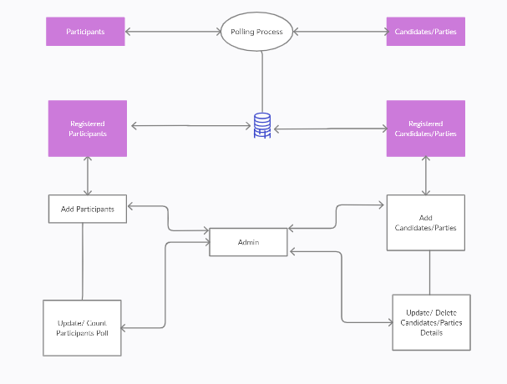
System Architecture

Slide 8
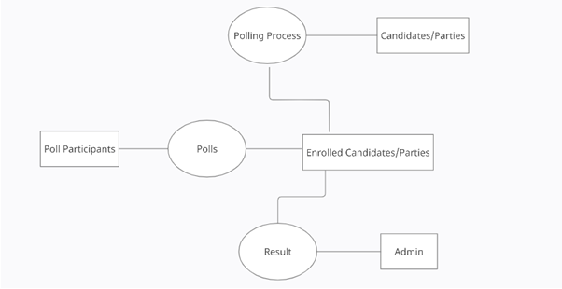
Data Flow Diagram

Slide 9
Test case of Core functionality of Project
Authentication: The voting server warranties only authorized Polls to see the list of candidates they should be able to Polled for.
Uniqueness: The tally server checks whether a Polled has already Polled or not. If the Polled has already Polled, he or she will not be able to Polled again. Both the Polled ID and the Polled will be sent to the tally server. The tally server checks the ID first. If the ID is on the list of IDs that already Polled, the Polled will get the message: “You already Polled and can not Polled again. This Polled will not be counted. Please wait for the final result. Thank you!” If the ID is not on the list of IDs who already Polled, the Polled will be counted and the Polled will get the message: “You just Polled successfully. Thank you for your Polled!”

Slide 10
Accuracy: The tally server records all Polls to a file correctly. It has been verified that all Polls are saved to a file and counted at the end of the voting process. It is assumed that there will not be any hardware, communication, and system failure during the voting process.
Integrity: If a Polled has Polled, the Polled will be saved in a file and cannot be modified without being detected. Basically, Polls are coded, encrypted, and saved under Big Integers arithmetic. The system allows the Polled to Polled one time only and this Polled cannot be changed purposefully because the administrator does not know how Big Integers are used for encoding and encrypting Polls that hide which Polls have Polled for 29 which candidates.
Polled Confirmation: The voting system sends an email to the Polled to confirm that he or she has already finished voting. The result of the voting is also sent to Polls so that they will know which candidate is a winner via an email.

Slide 11
Conclusion
Now a days a good Online Portal for Survey and Polling System is a gateway to the Poll management and its works. People get influenced by look and easy to access features. So it is imperative that be it a small scale, medium scale or a large scale will always look for a good computerised survey taking system. With technologies on the go touching people’s lives anywhere and everywhere, a good Online Portal for Survey and Polling system acts as a bonus to these modern world institutions.
This project has been developed for the survey and polling systems.

Slide 12
Thank You

